Slide 1
On The Computational Bayesian Survival Spatial DHF Modelling with CAR Frailty
Dwi Rantini¹, Ni Luh Putu Ika Candrawengi¹, Nur Iriawan^{1, a)}, Irhamah¹, and Musofa Rusli²
¹Department of Statistics, Faculty of Science and Data Analytics, Institut Teknologi Sepuluh Nopember, Surabaya, Indonesia ²Department of Internal Medicine, Faculty of Medicine, Universitas Airlangga, Surabaya, Indonesia

Slide 2
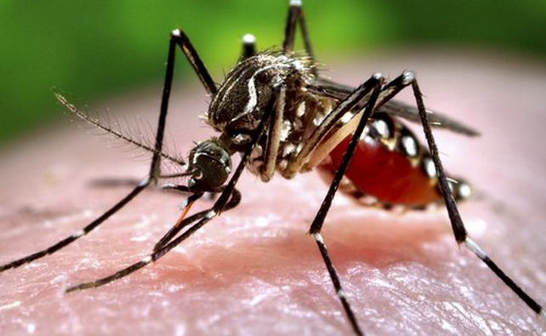

Introduction
Indonesia is a tropical country. Has two seasons, Raniy and Dry Season. On the rainy season, there are many viruses, bacteria, fungi, and parasites that can develop quickly because of the humidity.
One of the viruses that develop quickly on rainy season is Dengue viruses. This viruses is the main cause of Dengue Hemmorraghic Fever (DHF). Aedes Aegypt mosquitos carries the dengue viruses.

Slide 3
Number of DHF case in Jawa Timur 2018

Slide 4
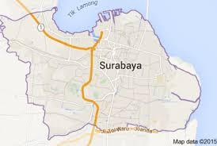
DHF Case in Surabaya
Number of DHF case in Surabaya is 321 case on 2018.

Slide 5
Introduction
A
Spatial Information
B
Conditionally Autoregressive (CAR)
C
Cox Model
D
Bayesian
The main factor of the recovery of DHF Patients
Host
Viruses
Environment
Environment can’t be forgotten especially because of the spreading of the viruses is very dependent on the location due to the movement of DHF patients and the range of Aedes aegypti mosquitos fly.

Slide 6
Proportional Hazard Model
Model that determine the hazard function as a representation of the probablitiy that an object risk will experience an event within a certain time period.
General approach :
Goodness of Fit
Graphical approach
Time dependent variables

Slide 7
Spatial Autocorrelation
Spatial autocorrelation is a condition where there are similarities or differences in certain attributes in areas that are close together.
General approach :
Local spatial autocorrelation
Global Spatial Autocorrelation, using Moran’s I
Interpretation of Moran’s I Value :
When it is getting closer to 1, the locations have a stronger spatial autocorrelation positively,
When it approaches 0, there is no spatial autocorrelation among locations,
When it comes close to -1, the locations have increasingly negative spatial autocorrelation.
Moran’s I Formula :

Slide 8
Conditionally Autoregressive (CAR) Prior
Standar survival model assumes that random or frailty effects are Independent
Combination of spatial location or area of observation and random effects
Using normal distribution with a conditional average valued at the average random effect for neighbors of the area and the conditional variance is inversely proportional to the number of neighbors of the area.
Proportional hazard model with spatial random effects

Slide 9
Bayesian Analisis
Bayesian analysis is one tool for estimating parameters models, treating all unknown parameters as random variables having a distribution.
Prior distribution is information that consist or represent random parameter of data.
Using posterior for making decision.
Type of Prior in Bayesian :
Informative and non-informative prior.
Conjugate and non-conjugate prior.
Proper and improper prior.
Pseudo prior.

Slide 10
Watanabe Akaike Information Criterion (WAIC)
WAIC is one of the Bayesian approaches for estimating out-of-sample approximation
Compared to deviance information criterion (DIC) and Akaike information criterion (AIC), WAIC can be viewed as an improvement on them for the Bayesian mode

Slide 11
Research Method
Secondary Data
Data obtained from the medical record of DHF patients in dr. Soetomo Hospital Surabaya. Medical record time starts from 1 January 2016 to 31 December 2019

Slide 12
Research Method
Symbol | Information of Variables | Unit or value
t | The duration of patients to meet recovery event | Days
δ | The indicator of censored data | (1: uncensored; 0: censored)
X₁ | Gender | (1: female; 0: male)
X₂ | Age | Years
X₃ | Last education | (1: high schools; 2: universities; 3: others)
X₄ | Types of occupations | (1: public servants, 2: private employees; 3: unemployed; 4: others; 5: housewife)
X₅ | DHF stadium | (1: stadium-I, 2: stadium-II; 3: stadium-III)
X₆ | Fever days before entering hospital | Days
X₇ | Pulse | Times/minute
X₈ | Respiratory | Times/minute
X₉ | Temperature | Celsius
X₁₀ | Hemoglobin | g/dL
X₁₁ | Hematocrit | %
X₁₂ | Leukocytes | 10³/uL
X₁₃ | Platelets | 10³/uL
S | Sub-district | (1: Tenggilis Mejoyo, 2: Gunung Anyar, 3: Rungkut, 4: Sukolilo, 5: Mulyorejo, 6: Gubeng, 7: Tambaksari)

Slide 13
Results and Analysis
Distribution of data are 2-parameter Weibull or 3-parameter Generalized Gamma distribution
Average time duration from entering hospital until meet recovery event of patient is 4 days.
FIGURE 1. The number of DHF patients on each sub-district in Eastern Surabaya
From Figure 1, the color of the figure shows the number of patients in each sub-distict in Surabaya. Darker color shows that greater number of DHF patients rather than the light color.

Slide 14
Detecting Spatial Autocorrelation
TABLE 2. Neighborhood List for Sub-district in Eastern Surabaya
Sub-district | Number of Neighbors | List of Neighbors
Tenggilis Mejoyo | 4 | Gunung Anyar, Rungkut, Sukolilo, Gubeng
Gunung Anyar | 2 | Tenggilis Mejoyo, Rungkut
Rungkut | 3 | Tenggilis Mejoyo, Gunung Anyar, Sukolilo
Sukolilo | 4 | Tenggilis Mejoyo, Rungkut, Mulyorejo, Gubeng
Mulyorejo | 3 | Sukolilo, Gubeng, Tambaksari
Gubeng | 4 | Tenggilis Mejoyo, Sukolilo, Mulyorejo, Tambaksari
Tambaksari | 2 | Mulyorejo, Gubeng
Adjacent Matrix
2,3,4,6,
1,3,
1,2,4,
1,3,5,6,
4,6,7,
1,4,5,7,
6,5
Moran’s I Index
0,407738
There is spatial autocorrelation on DHF case in Surabaya

Slide 15
Proportional Hazard Assumption
Proportional hazard test using Grambsh and Thernau global test for the overall simultaneously show p-value 0,8076 and can be conluded that the proportional hazard assumption has already fullfilled

Slide 16
Implementing Cox model on 2-parameter Weibull distribution
Probability density function (pdf) of Weibull distribution
Cox proportional hazard model with spatial effects on 2-parameter Weibull distribution

Slide 17
Implementing Cox model on 2-parameter Weibull distribution
Joint posterior of the Weibull model
Using prior

Slide 18
Implementing Cox model on 3-parameter Generalized Gamma Distribution
Pdf of 3-parameter Generalized Gamma distribution
Cox proportional hazard model with spatial effects on 3-parameter WeibGeneralized Gamma distribution
Where :

Slide 19
Implementing Cox model on 3-parameter Generalized Gamma Distribution
Joint posterior of 3-parameter Generalized Gamma model
Prior used
Where :

Slide 20
Comparison of Survival Spatial Model
TABLE 3. WAIC value for each model
Spatial Survival Model | WAIC
2-parameter Weibull distribution without Normal CAR | 93.01
2-parameter Weibull distribution with Normal CAR | 90.90
3-parameter Generalized Gamma distribution without Normal CAR | 147.10
3-parameter Generalized Gamma distribution with Normal CAR | 146.40
recovery rate of DHF patients model using the 2-parameter Weibull distribution coupled with spatial effect Normal CAR is the best model.
Model with spatial effect better than model without spatial effect.

Slide 21
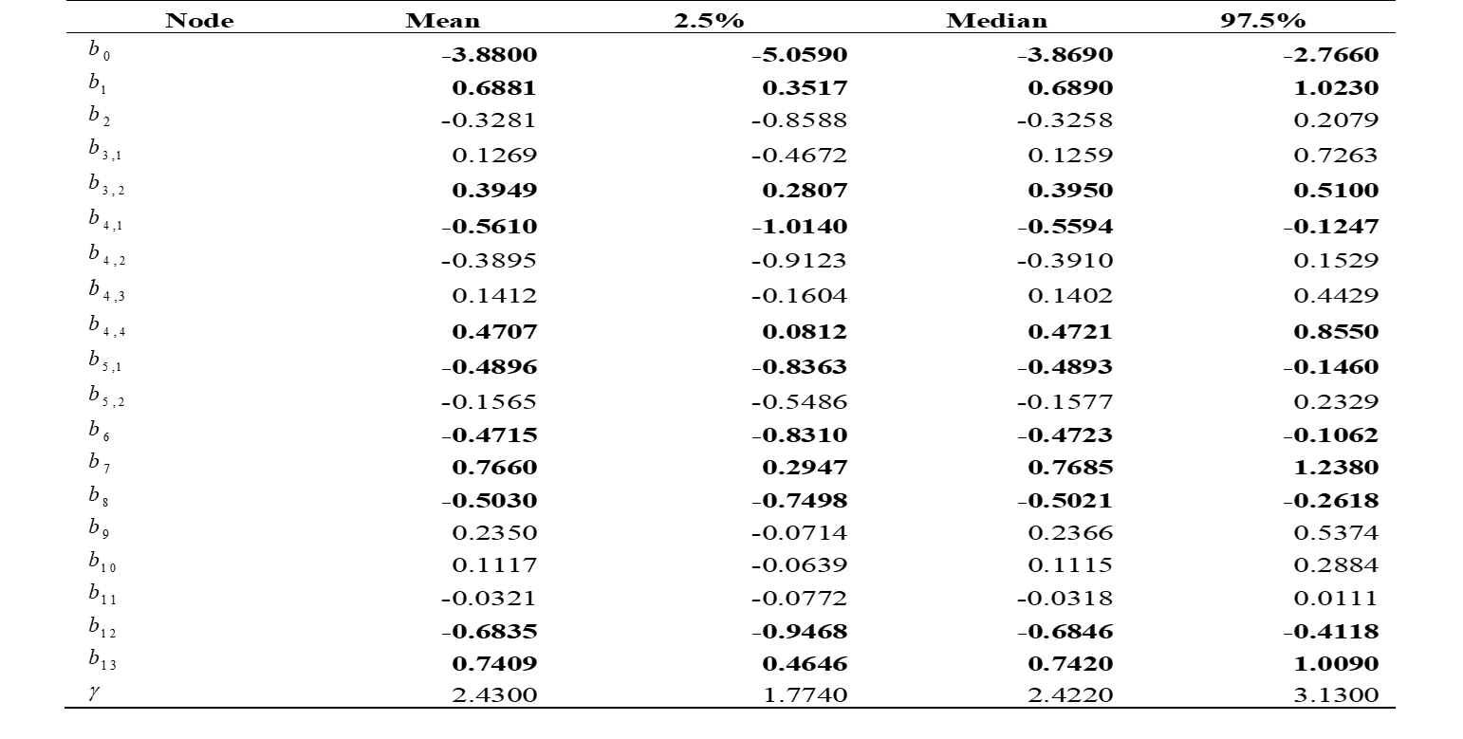
Parameter Estimation of 2-parameter Weibull Distribution Model
From the Table, factors having significant influence to the recovery rate of DHF patients are gender, universities in last education, public servants and others in type of occupations, stadium I in severity level, fever days before entering hospital, pulse, respiratory, leukocytes and platelets

Slide 22
Model of Survival Spatial with CAR Normal on 2-parameter Weibull Distribution
Some factors, i.e. gender, universities in last education, others in the type of occupations, pulse, and platelets have positive coefficient. This means that increasing the value of these factors will accelerate the recovery rate of DHF patients.
public servants as the type of occupations, the stadium I in severity level, fever days before entering the hospital, respiratory and leukocytes have negative coefficient. This means that the acceleration of the patient's recovery rate would be slower when the value of these factors is increased.

Slide 23
Conclusion
Sub-district with the highest number of DHF patients are Tambaksari and Gubeng
Normal CAR gives a smaller WAIC value for both 2-parameter Weibull and 3-parameter Generalized Gamma models, thus it can be concluded that there is a spatial correlation between sub-districts in eastern Surabaya.

Slide 24
References
1. T. Pang, T. K. Mak, and D. J. Gubler, Lancet Infect. Dis. (2017).
2. W. H. Organization, Prevention and Control of Dengue and Dengue Haemorrhagic Fever (WHO Regional Office for South-East Asia, 1999).
3. J. J. Strouse, T. R. Fears, M. A. Tucker, and A. S. Wayne, J. Clin. Oncol. (2005).
4. R. Sarin, L. Khandrika, R. N. M. Hanitha, A. Avula, M. Batra, S. Kaul, H. Raj, S. Shivkumar, S. Gupta, E. Khan, T. P. S. Bhandari, S. V. S. S. Prasad, V. A. Reddy, G. Swarnalata, M. Bakre, S. Chatterjee, and J. Jain, Indian J. Cancer (2016).
5. S. Reader, in Soc. Sci. Med. (2000).
6. H. Scherm and P. S. Ojiambo, in Phytopathology (2004).
7. D. Darmofal, Am. J. Pol. Sci. 53, 241 (2009).
8. A. Aswi, S. Cramb, E. Duncan, W. Hu, G. White, and K. Mengersen, Int. J. Environ. Res. Public Health (2020).
9. A. Riebler, S. H. Sørbye, D. Simpson, H. Rue, A. B. Lawson, D. Lee, and Y. MacNab, in Stat. Methods Med. Res. (2016).
10. D. Obaromi, Biomed. J. Sci. Tech. Res. (2019).
11. N. Mahmudah, N. Iriawan, and S. W. Purnami, Indian J. Public Heal. Res. Dev. 9, 1586 (2018).
12. K. Motarjem, M. Mohammadzadeh, and A. Abyar, J. Math. Sci. (United States) 237, 692 (2019).
13. S. Banerjee, M. M. Wall, and B. P. Carlin, Biostatistics 4, 123 (2003).
14. N. Mahmudah and H. Pramoedyo, Nat. B (2015).
15. S. A. Thamrin and I. Taufik, in J. Phys. Conf. Ser. (2018).
16. D. R. Cox, J. R. Stat. Soc. Ser. B (1972).

Slide 25
References
17. D. G. Kleinbaum and M. Klein, New York, Springer-Verlag (2011).
18. D. G. Kleinbaum and D. G. Kleinbaum, in Surviv. Anal. (1996).
19. D. Schoenfeld, Biometrika (1982).
20. P. M. Grambsch and T. M. Therneau, Biometrika (1994).
21. X. Li, W. Li, L. Anselin, S. Rey, and J. Koschinsky, in Proc. 3rd ACM SIGSPATIAL Int. Work. Anal. Big Geospatial Data, BigSpatial 2014 (2014).
22. P. J. Tsai, M. L. Lin, C. M. Chu, and C. H. Perng, BMC Public Health (2009).
23. J. Besag, J. York, and A. Mollié, Ann. Inst. Stat. Math. 43, 1 (1991).
24. N. Cressie and C. K. Wikle, Statistics for Spatio-Temporal Data (John Wiley & Sons, 2015).
25. M. Morris, K. Wheeler-Martin, D. Simpson, S. J. Mooney, A. Gelman, and C. DiMaggio, Spat. Spatiotemporal. Epidemiol. (2019).
26. N. Iriawan, Lap. Penelit. (2001).
27. G. E. P. Box and G. C. Tiao, Reading, MA (1973).
28. I. Ntzoufras, Bayesian Modeling Using WinBUGS (John Wiley & Sons, 2008).
29. S. Geman and D. Geman, IEEE Trans. Pattern Anal. Mach. Intell. PAMI-6, 721 (1984).
30. A. Gelman, J. B. Carlin, H. S. Stern, D. B. Dunson, A. Vehtari, and D. B. Rubin, Bayesian Data Analysis, Third Edition (2013).
31. A. Vehtari, A. Gelman, and J. Gabry, Stat. Comput. (2015).

